Slide 1
Mobile Application to Improve Mental Health of Persons with Dementia
PROJECT PITCH
Undergraduate Project – University of Bedfordshire, UK
Student Name: Nishshanka Nimesh Mendis
Student ID: 2012430
Academic Year: 2020 / 2021
Course: BSc. (Hons) Computer Science & Software Engineering
Supervisor: Mr. Vibhavi Attigala

Slide 2
Content
Background
Objectives
Literature Review
Project Methodology
Features
Research Outcomes
Evaluation
Tools used
Competitive Advantages
Discussion and Conclusion

Slide 3

Background
Research Considerations
Dementia is recognized as one of the growing social health problems
Dementia is caused by abnormal brain changes of a person
Dementia have difficulties in concentrating, their span of attention is low
Due to this reason, the caretakers find it difficult to handle them
Provide activities to remember things and build their attention through calm sounds
Insufficient functionalities in the existing system to solve the problems

Slide 4
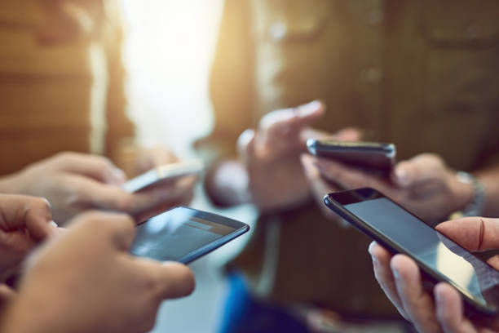
Solution
Solution Objectives
To Develop a mobile application to improve mental health and quality of life a person with Dementia.
To Identify the patient’s attributes properly relating to Dementia which is suitable to the patient.
Artificial intelligent chatbot function which is help user to manage their tasks and daily activities easily.
Memory recovery activities
Inbuild music player with songs list

Slide 5
Literature Review
Sundowning and Agitation
Busy-Boards
Alzheimer's and dementia patients typically get agitated late in the afternoon or early evening, according to research. “Sundowning” is a term used by those in the field to describe this condition
Busy-Boards are mobile applications that are intended to grab the user's attention by asking them to perform a basic activity. When a person is having an emotional meltdown, busy-boards seek to calm them down.
Music and Memory
Various groups, such as musicandmemory.org, have shown that music encourages otherwise unresponsive dementia patients to become more active and communicative.

Slide 6
Literature Review
COGNICARE
Artificial Intelligence
Cognicare also provide users to share their personal experience, their knowledge, and their good practices with each other in this application.
Artificial Intelligence (AI) refers to the simulation of human intelligence in machines that are programmed to think like humans and mimic their actions. The term may also be applied to any machine that exhibits traits associated with a human mind such as learning and problem-solving.
While Literature reviewed are connected to heavy implementations in general, influence and inspiration was received.
Some more examples are mentioned here, along with a successful implementation.
Dementia Guide Expert
This application is a personal guide mobile application targeted for the family, friends and care takers looking after people with Dementia.
A Walk Through Dementia
Application brings out Virtual Reality experience to the user. Another objective of this project was trying to recreate what persons with dementia see and how they feel

Slide 7
Project Methodology
Agile Software Development Lifecycle
Planning
Requirement gathering & Analysis
Sprint One Designing Application Layouts.
Sprint Three Implement Algorithm
Evaluation & Documentation
Sprint Two implement Classes and Firebase DB
Requirements
Designing
Requirement analysis was carried out initially through the literature review of previous work related, while a market research conducted; confirmed the target demographic and their preferences.
Utilizing UML diagrams, the behavior of the expected system was finalized while the product with the functional logic being based on idea of Artificial Intelligence.
Methodology
• Distinctive functionalities of
the application was divided
and implemented
separately
Implementation
Quality
Dementia Care was implemented on the android mobile platform using Android Studio and Google’s Firebase with Java being the programming language of choice. AI chatbot as built in PyCharm with Python language
Each monthly supervisor meeting and the Agile software development lifecycle itself accounted up for a respectable quality assurance in terms of producing an acceptable final delivery.
7

Slide 8
Features
Dementia Care Mobile Application
User can enter their credentials in Login Interface to enter to the system
New user can registered in to the system using Registration Interface
Dashboard Interface
User can View their profile
User can engage with Recognizing colors activity
User can engage with Recall items activity
User can use AI chatbot get help
To-do list Interface
Reminder Interface
Music Player

Slide 9

Solution
Outcome of the Research
To Develop a mobile application to improve mental health and quality of life a person with Dementia.
To Identify the patient’s attributes properly relating to Dementia which is suitable to the patient.
Artificial intelligent chatbot function which is help user to manage their tasks and daily activities easily.
Memory recovery activities
Inbuild music player with songs list

Slide 10
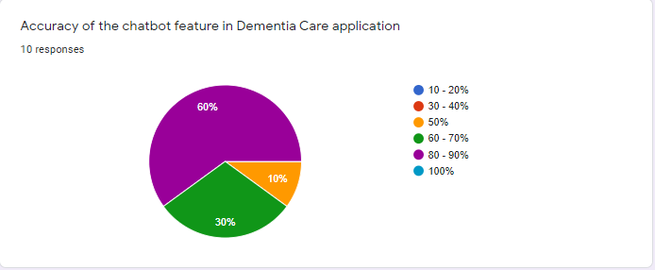
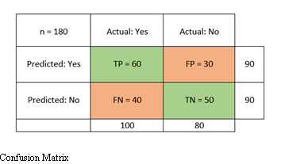
Evaluation
The researcher discovered that the chatbot has a better success rate of accuracy, with in the range of 80-90 percent of accuracy showed 60% success rate out of general responses.
This importance demonstrates that, in order to achieve a higher accuracy score, the chatbot must also accurate.
N = 40 (Target Population)
n = 10 (Random Selected Population)
Pie chart of user evaluation question four

Slide 11
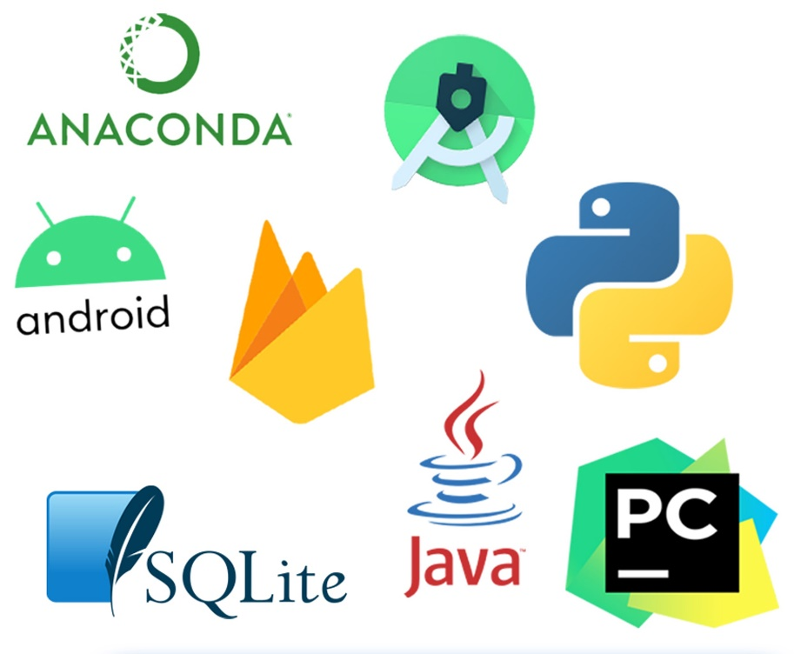
Tools Used
Tools
Microsoft word
Android studio IDE
Java programming language
PyCharm
Python programming language
Draw.io
Libraries
NLTK (Natural Language toolkit)
Flask (API)
TensorFlow (free and open-source software library for machine learning)
Keras Model (Deep learning API)
Web Services
Cloud firebase database
Firebase authentication
Firebase storage

Slide 12

Competitive Advantage
Future Work
Integrated AI chatbot
System that store reminders and display notifications
Memory recovery activities
In build music player with a playlist
Available free of charge
User friendly and flexible
Improving recommendation functionality with dynamic questions
Increasing product scope
Improving the AI chatbot and increasing the accuracy
Embedding better and more efficient technologies such as prediction model
Moving onto cross platform implementation
Hope to bring forward application for industrial level

Slide 13
Discussion & Conclusion
Major Achievements
Major Limitations
Recommendations
Learning the importance and the effort required in implementing using the basic idea of artificial intelligence and algorithms.
Developing a user friendly platform capable of viewing statistics of past preferences and recommending mobile phones, preferences using a idea of Artificial intelligence with .natural language toolkit and deep learning techniques
Identifying research shortcomings and evaluating methods to improve existing issues in the future of development with reference to additional technologies.
The system is only limited in the English language due to a lack of overall language literacy.
Now, it is just a mobile application, although it can be adapted for other platforms in the future.
Problems occurred in chatbot due to insufficiency of knowledge and training
The application is only developed for Android OS users, since it has not yet been developed for IOS devices.
Access to application is restricted where there is no or a weak internet service.
Implement the database on a relational basis or learn to improvise by using cloud functions and external services.
The application can be developed in IOS for Apple users. Also allow users to use the application in multiple languages

Slide 14
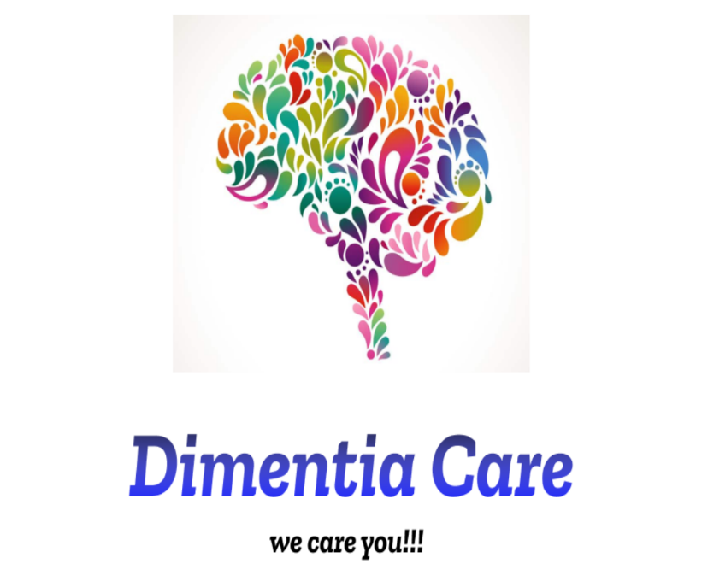
Thank You
Email: dementiacare29113@gmail.com

